Slide 1
Traffic Lights Irregularity Detection SYSTEM
Using Deep Learning – YoloV8 Approach
SUMMER
INTERNSHIP
BHANU SUMANTH
100520733013
VAMSI KRISHNA
100520733014

Slide 2
Motivation/PROBLEM STATEMENT:
Problem Statement: Develop a Deep learning algorithm that can detect Irregularities/Malfunctions in Traffic lights through Video Classification.
The algorithm should be able to accurately identify each stage of the traffic light(red, yellow, green) even in videos taken at a angle.
The algorithm should be able to correctly determine whether the traffic lights have any kind of malfunctions.
It should also have a low false positive rate, so that it does not generate too many unnecessary alerts.

Slide 3
Technologies used:
Deep Learning.
OPEN CV (COMPUTER VISION).
YoloV8 (Ultralytics).
Convolutional Neural Networks (CNN).
IPython.
moviepy (MoviePy is a Python library for video editing: cutting, concatenations, title insertions, video compositing etc…)

Slide 4
Contents:
BRIEF INTRODUCTION TO DEEP LEARNING AND COMPUTER VISION.
DATASET USED:
VISUALIZING THE DATA FROM THE DATASET.
OUR APPROACH:
PRE-PROCESSING.
Custom YoloV8 MODEL IMPLEMENTATION.
WHAT IS YoloV8?
WHAT IS CNN?
CLASS PREDICTION ON EXTERNAL OR UNSEEN VIDEOS.

Slide 5
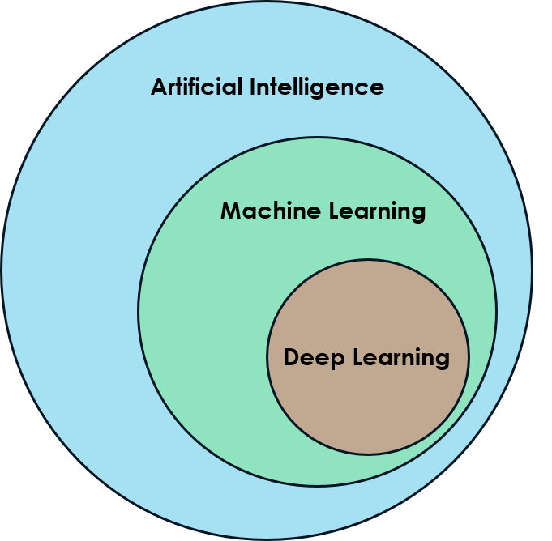
What is deep learning?:
Deep learning is a subset of machine learning, which is essentially a neural network with three or more layers. These neural networks attempt to simulate the behavior of the human brain, albeit far from matching its ability allowing it to “learn” from large amounts of data.
While a neural network with a single layer can still make approximate predictions, additional hidden layers can help to optimize and refine for accuracy.

Slide 6
Why deep learning instead of machine learning?:
Deep learning reduces part of the data pre-processing required by machine learning.
These algorithms can ingest and interpret unstructured data such as text and pictures, and they automate feature extraction, reducing reliance on human specialists.
Assume we have a collection of images of various pets that we wish to categorize by "cat", "dog", "hamster", and so on.
Deep learning algorithms can determine which features (e.g. ears) are most important to distinguish each animal from another. In machine learning, this hierarchy of features is established manually by a human expert.

Slide 7
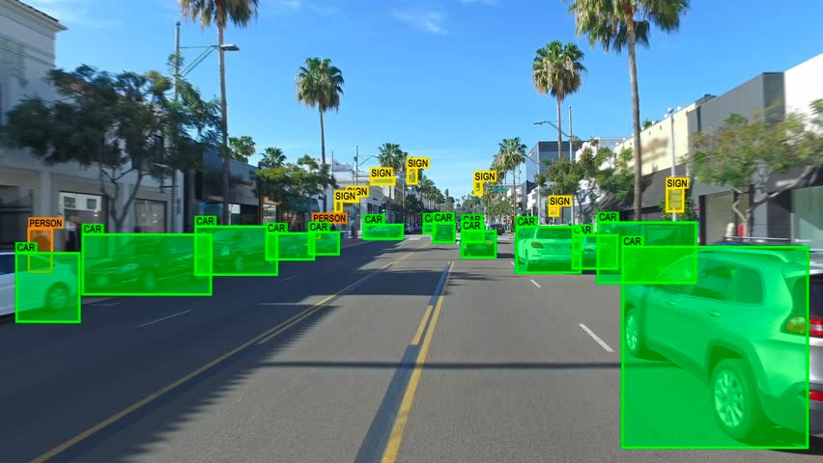
What is computer vision?:
Computer vision is a branch of artificial intelligence (AI) that enables computers to observe, recognise, and comprehend real-world objects. It is utilised in many different applications, including as self-driving automobiles, robots, and facial recognition.
Deep learning and computer vision are closely connected. It is frequently used to power computer vision applications because it can learn to recognise patterns in pictures and videos that standard computer vision algorithms would struggle to discern.

Slide 8
Dataset used:
We will be using the Dataset consists of
Road signs dataset from roboflow (https://universe.roboflow.com/usmanchaudhry622-gmail-com/traffic-and-road-signs) consisting of images of different traffic light signals .
The Dataset contains:
21 Different Class Categories.
Over 10000 images of all Class Category.

Slide 9

Our Approach:
The Architecture has different phases like:
Step 1: Video pre-processing.
Step 2: Training the pre-trained model .
Step 3: Prediction of Class using the Model.

Slide 10
Step 1:Pre-Processing
The dataset is cleaned by removing any other category of data that is not required.
By passing the “data.yaml” file and cleaning the data such that no other classes are detected in training.
Our model is able to train faster without being affected by unnecessary data.
Also clearing the images and labels of unnecessary data in directories of train, valid and test folders.

Slide 11
Step 1:Pre-Processing contd….
After Pre-Processing we will be left with dataset folder with:
images: images in dataset(around 294)
red_light = 100
yellow_light = 94
green_light = 100
labels: A file containing the
class,
x(x_coordinate of center of bounding box),
y(y_coordinate of center of bounding box),
w(width of bounding box),
h(height of bounding box)
for every corresponding image in images.

Slide 12
Step 1:Pre-Processing END
Now that we have the required classes of dataset images and labels files(a file containing class labels and bounding box coordinates).
We will split our data to create train and valid sets the split is (80:20).We will also shuffle the dataset before the split to avoid any bias and get splits representing the overall distribution of the data.

Slide 13
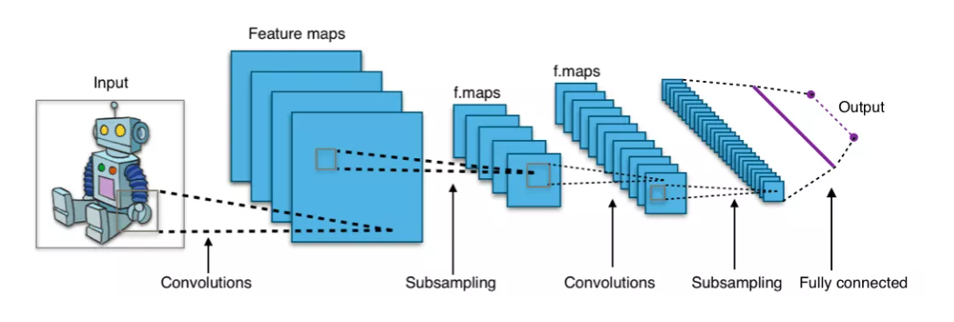
Step 2 : What is CNN (convolutional neural network)?
A Convolutional Neural Network (CNN or ConvNet) is a type of deep neural network that is specifically designed to work with image data and excels when it comes to analyzing the images and making predictions on them.
It works with kernels (called filters) that go over the image and generates feature maps (that represent whether a certain feature is present at a location in the image or not) and initially it generates few feature maps and as we go deeper in the network the number of feature maps is increased and the size of maps is decreased using pooling operations without losing critical information.

Slide 14
Step 2 CONTD…: WHAT IS Yolov8?
We will implement the pretrained YOLOv8 model named ‘yolov8n.pt’.
YOLOv8 is a real-time object detection algorithm that uses a single neural network to predict bounding boxes and class probabilities for multiple objects in an image. It is the latest version of the popular YOLO family of algorithms, and it offers a number of improvements over previous versions, including:
Increased accuracy: YOLOv8 achieves state-of-the-art accuracy on a number of object detection benchmarks.
Faster speed: YOLOv8 is faster than previous versions of YOLO, making it suitable for real-time applications.
More robust: YOLOv8 is more robust to occlusions and other challenges than previous versions of YOLO.

Slide 15

Step 2 CONTD…: WHAT IS Yolov8?

Slide 16
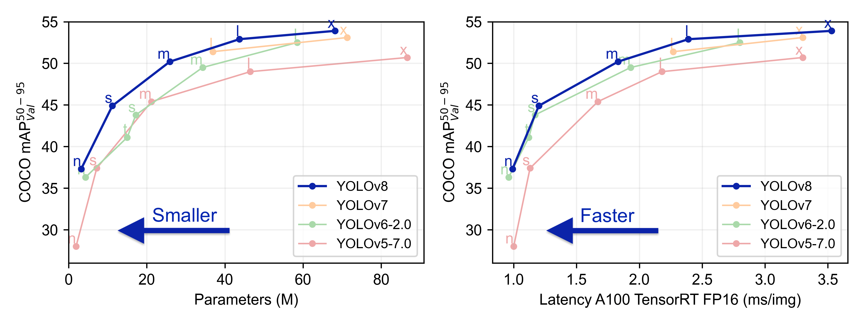
Step 2 CONTD…: WHAT IS Yolov8?
Yolov8 performance compared to its predecessor yolo models.

Slide 17
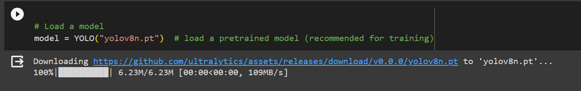
STep 2 CONTD…: MODEL CREATION AND IMPLEMENTATION.
Get the Pretrained YoloV8 Model using the YOLO(‘yolov8n.pt’) method given below:

Slide 18
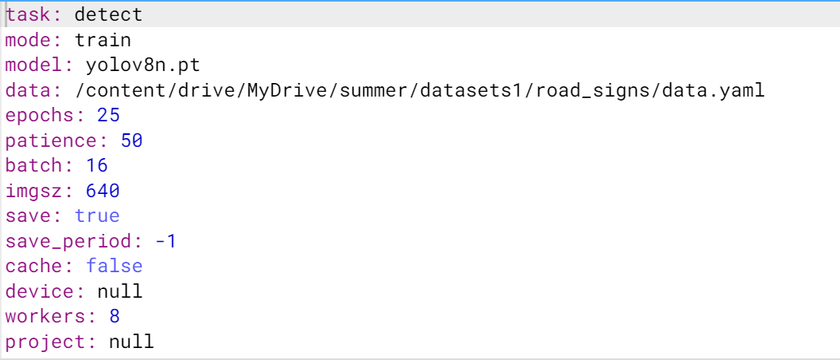
STep 2 CONTD…: MODEL CREATION AND IMPLEMENTATION.
Arguments given during Training

Slide 19
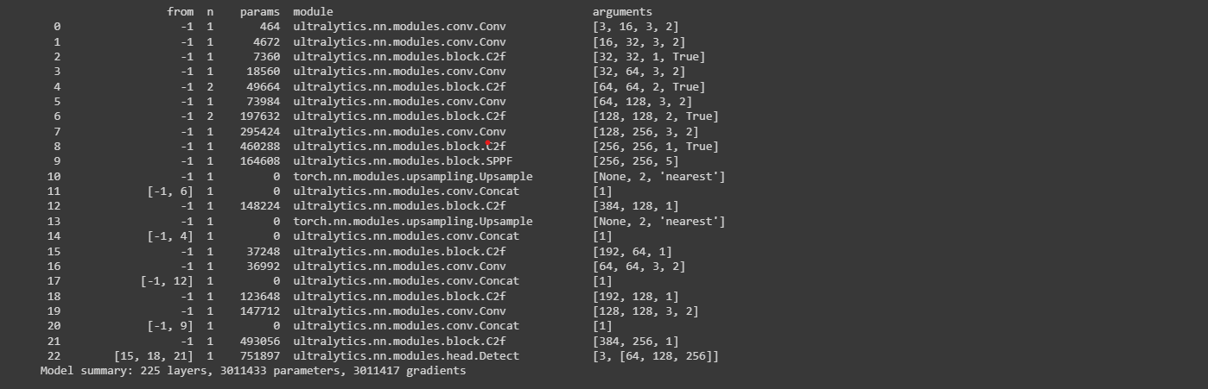
STEP 2 CONTD… : YOLOV8 Model:
Summary of Yolov8 model used

Slide 20
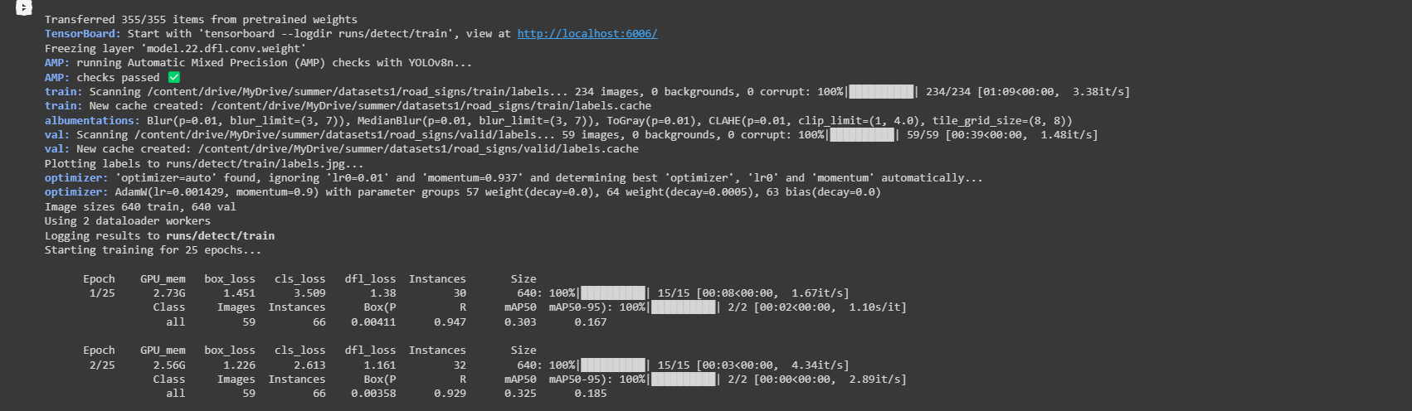
STEP 2 CONTD… : Yolov8 Model Training:
The Optimizer is AdamW.
The Learning rate is 0.001429.
Image sizes of images in train and validation data is 640

Slide 21
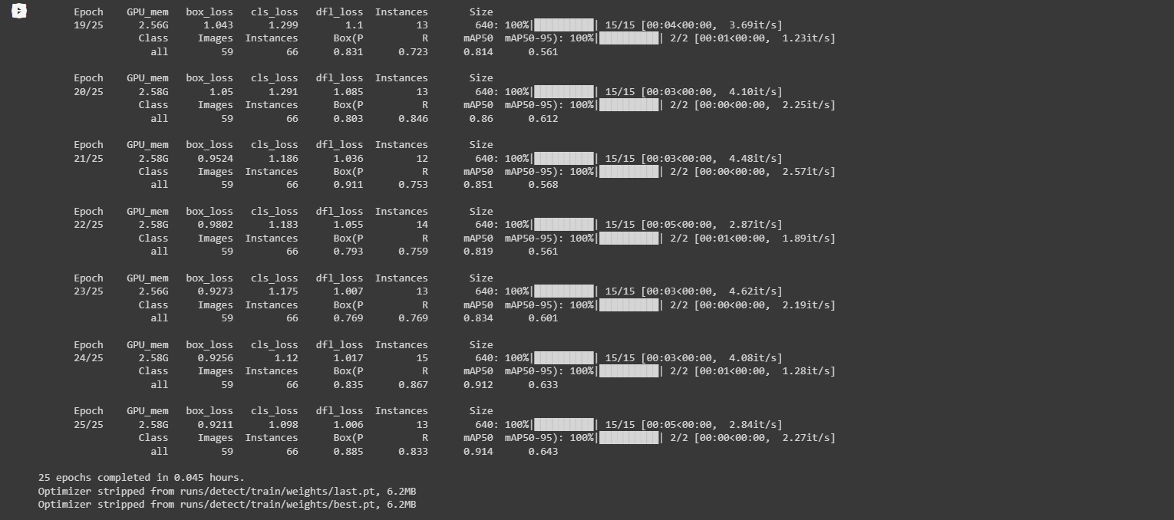
STEP 2 CONTD… : Yolov8 Model After Training:
The Last Six Epochs in Model Training.
Total Training Time of 25 epochs took 0.045 hrs.
The best weights and last recorded weights are given as output.

Slide 22
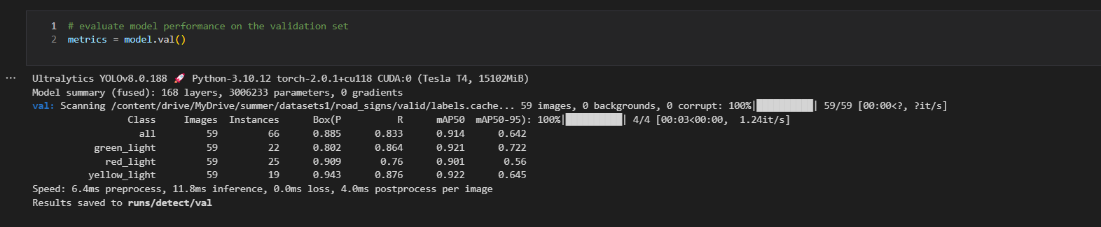
STEP 2 CONTD… : custom trained Model Evaluation on Validation data:
By using model.val() we test our model on validation data :

Slide 23
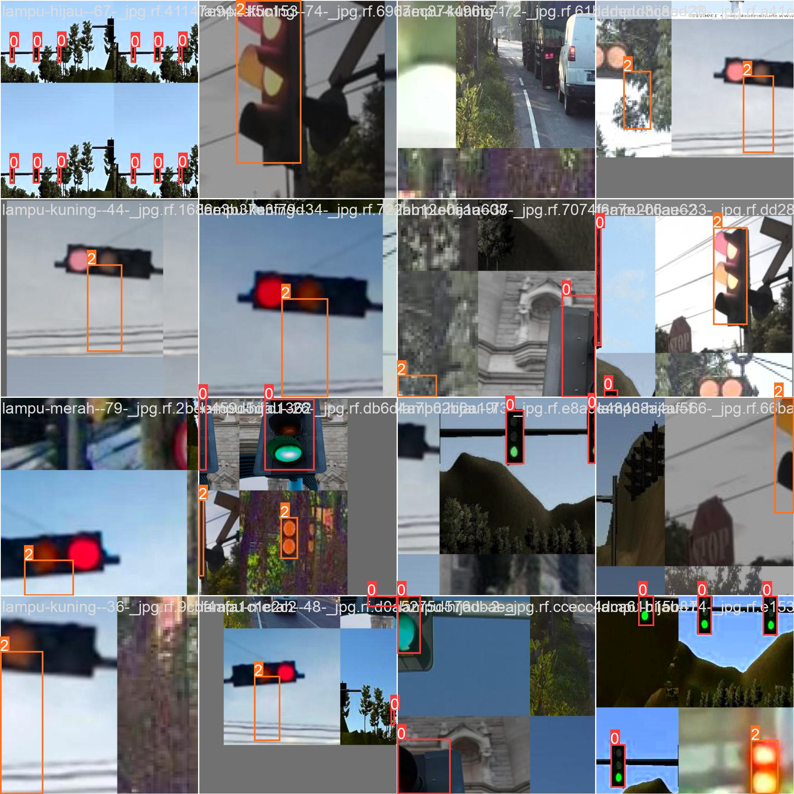
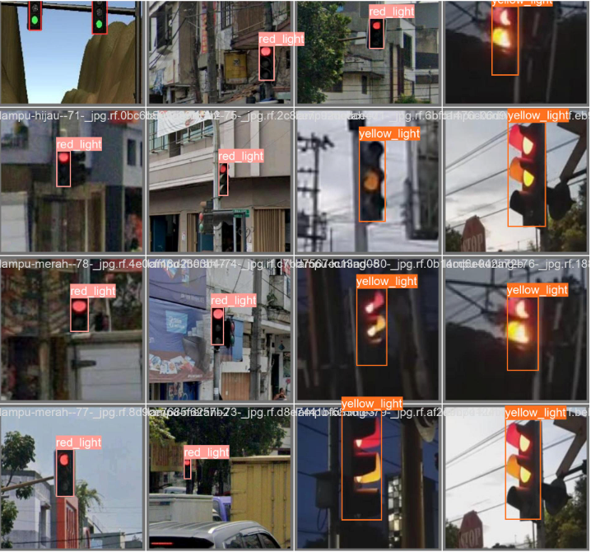
STEP 2 CONTD… : custom trained Model Evaluation on Validation data:
We get batch results of images during training and validation, which show our models improvement.
During Training During Validation

Slide 24
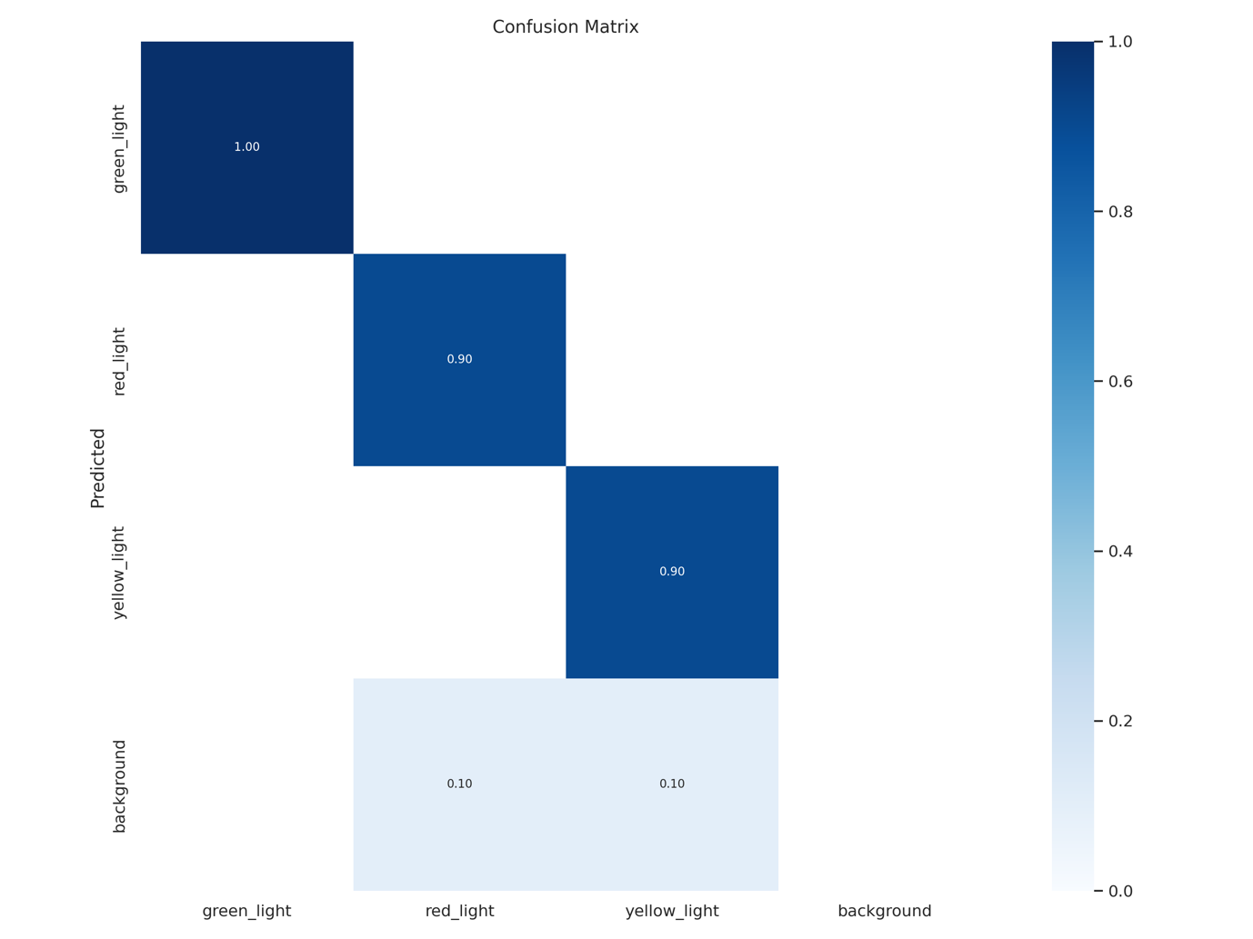
STEP 2 CONTD… : Visualizing the confusion matrix of Yolo model
By using Image() from Ipython library we can display the confusion matrix. As shown below:

Slide 25
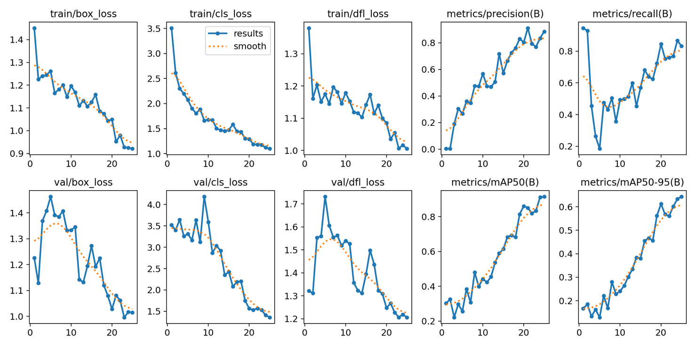
STEP 2 CONTD… : Visualizing the training and validation metrics:
By using Image() from Ipython library we can display metrics of training and validation data. As shown below:

Slide 26
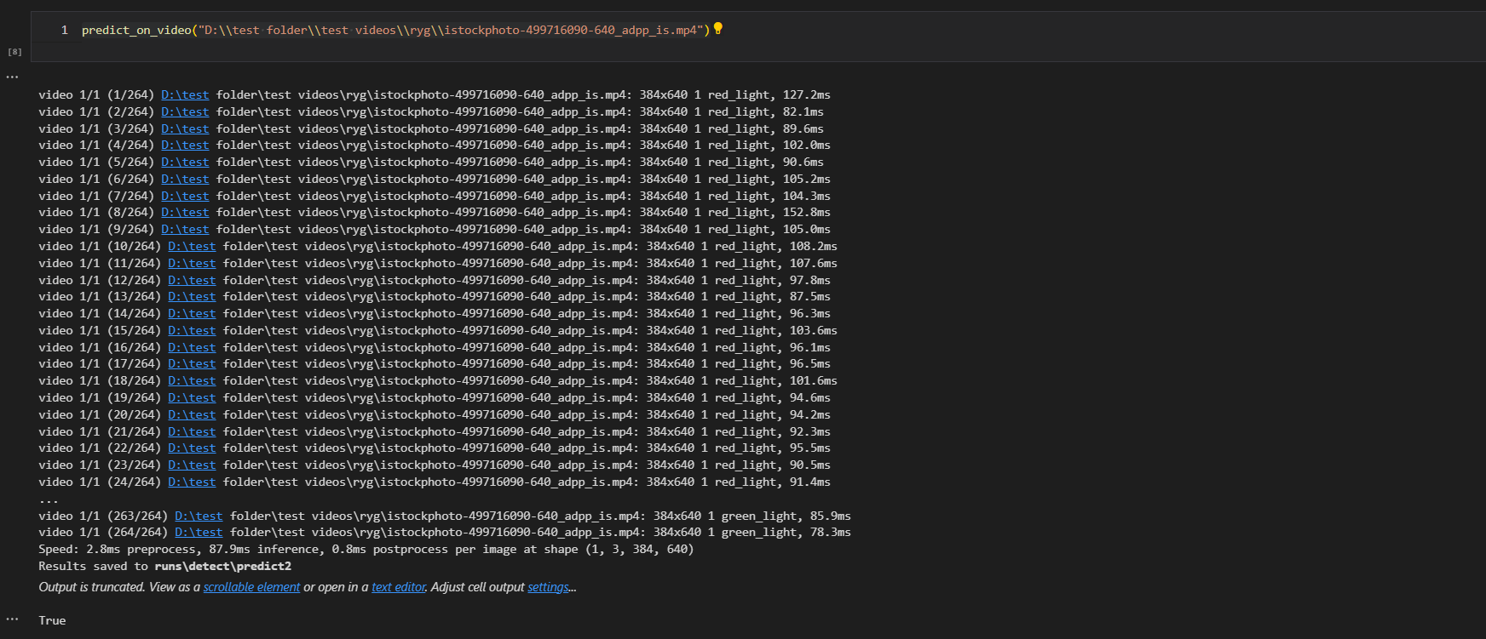
Step 3 : Class prediction using model :
We predict the class of traffic light irregularity in a given video using the model:
As seen below the model makes a prediction on the video giving output ‘True’ indicating that this traffic light does not skip yellow light during transition.

Slide 27
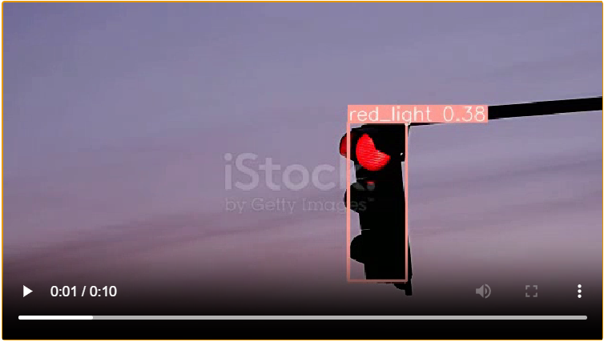
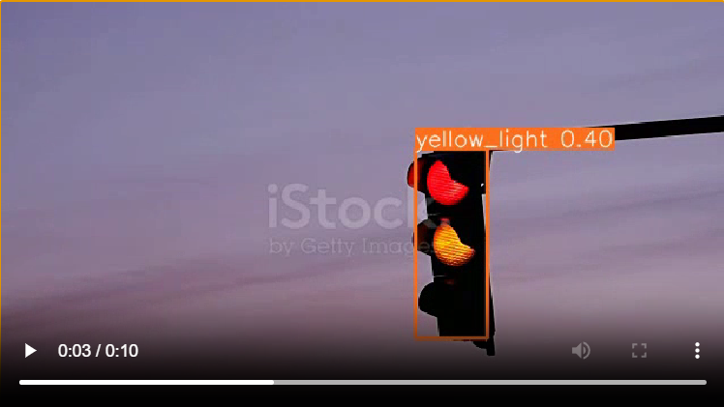
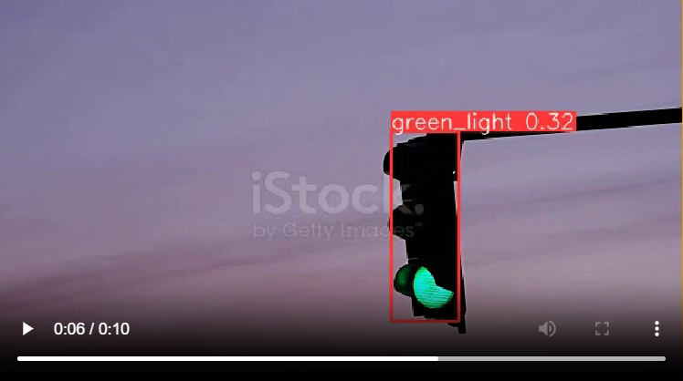
Step 3 contd… : prediction on video with Irregular Traffic Lights:
Given a video with irregular traffic lights the output video is made so that the video contains labels on the bounding box predicting the traffic color detected in each frame.
This is a Prediction made by the model on a unseen video as seen the output class was ‘True’ (no irregularity as it does not skip yellow)

Slide 28
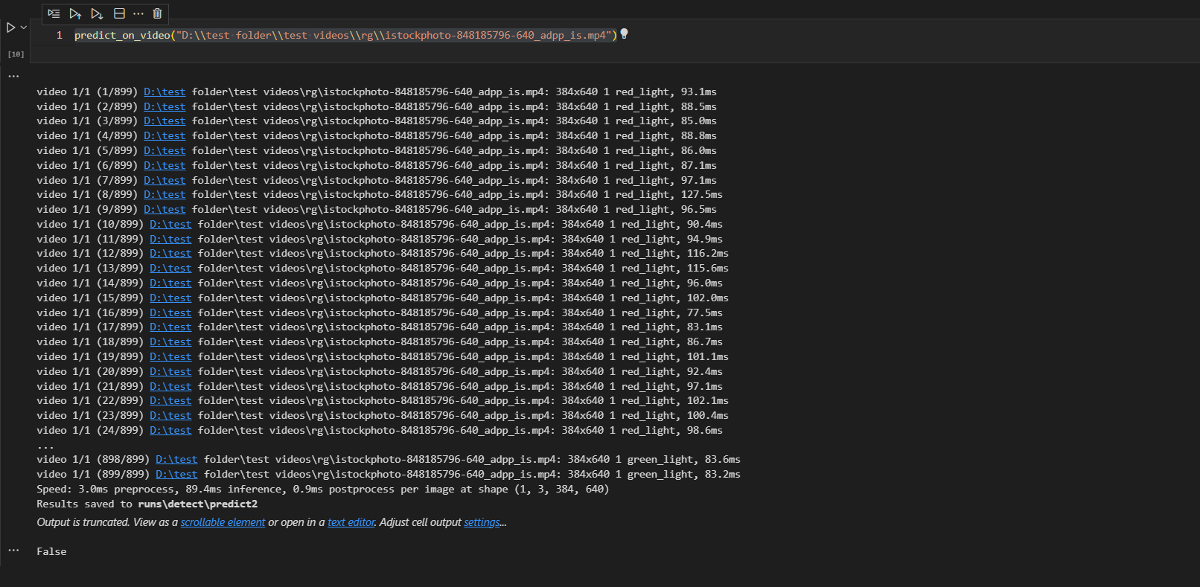
Step 3 : Class prediction using model :
We predict the class of traffic light irregularity in a given video using the model:
As seen below the model makes a prediction on the video giving output ‘False’ indicating that this traffic light skips yellow light during transition.

Slide 29
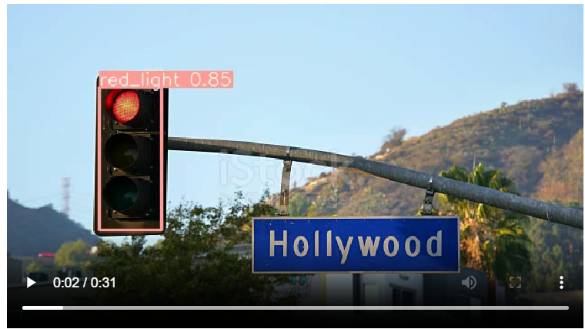
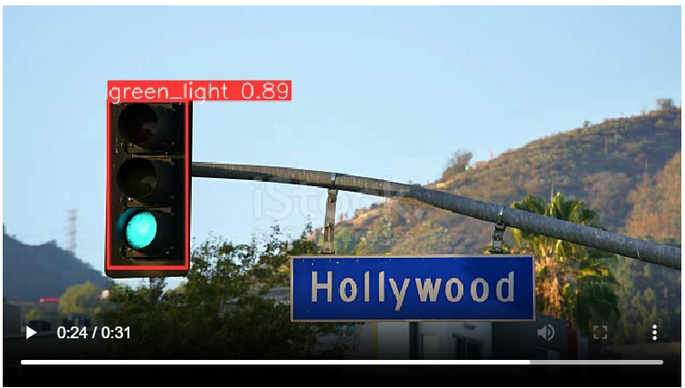
Step 3 contd… : prediction on video with Irregular Traffic Lights:
Given a video with irregular traffic lights the output video is made so that the video contains labels on the bounding box predicting the traffic color detected in each frame.
This is a Prediction made by the model on a unseen video as seen the output class was ‘False’ (no irregularity as it skips yellow)

Slide 30


